Slide 1
Feature Selection

Slide 2
Feature Selection
Overview
Perspectives
Aspects
Most Representative Methods
Related and Advanced Topics
Experimental Comparative Analyses

Slide 3
Feature Selection
Overview
Perspectives
Aspects
Most Representative Methods
Related and Advanced Topics
Experimental Comparative Analyses

Slide 4
Overview
Why we need FS:
  to improve performance (in terms of speed, predictive power, simplicity of the model).
  to visualize the data for model selection.
  To reduce dimensionality and remove noise.
Feature Selection is a process that chooses an optimal subset of features according to a certain criterion.

Slide 5
Overview
Reasons for performing FS may include:
  removing irrelevant data.
  increasing predictive accuracy of learned models.
  reducing the cost of the data.
  improving learning efficiency, such as reducing storage requirements and computational cost.
  reducing the complexity of the resulting model description, improving the understanding of the data and the model.

Slide 6
Feature Selection
Overview
Perspectives
Aspects
Most Representative Methods
Related and Advanced Topics
Experimental Comparative Analyses

Slide 7
Perspectives
searching for the best subset of features.
criteria for evaluating different subsets.
principle for selecting, adding, removing or changing new features during the search.

Slide 8
Perspectives:
Search of a Subset of Features
FS can be considered as a search problem, where each state of the search space corresponds to a concrete subset of features selected.
The selection can be represented as a binary array, with each element corresponding to the value 1, if the feature is currently selected by the algorithm and 0, if it does not occur.
There should be a total of 2^{M} subsets where M is the number of features of a data set.

Slide 9
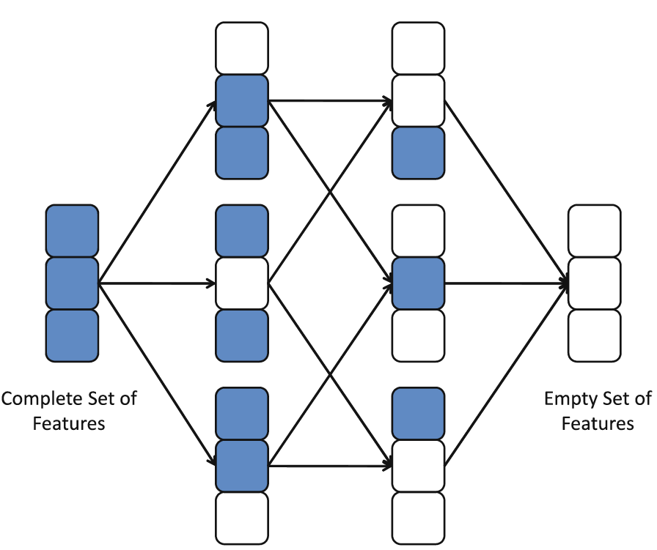
Perspectives:
Search of a Subset of Features
Search
Space:

Slide 10
Perspectives:
Search of a Subset of Features
Search Directions:
  Sequential Forward Generation (SFG): It starts with an empty set of features S. As the search starts, features are added into S according to some criterion that distinguish the best feature from the others. S grows until it reaches a full set of original features. The stopping criteria can be a threshold for the number of relevant features m or simply the generation of all possible subsets in brute force mode.
  Sequential Backward Generation (SBG): It starts with a full set of features and,iteratively, they are removed one at a time. Here, the criterion must point out the worst or least important feature. By the end, the subset is only composed of a unique feature, which is considered to be the most informative of the whole set. As in the previous case, different stopping criteria can be used.

Slide 11
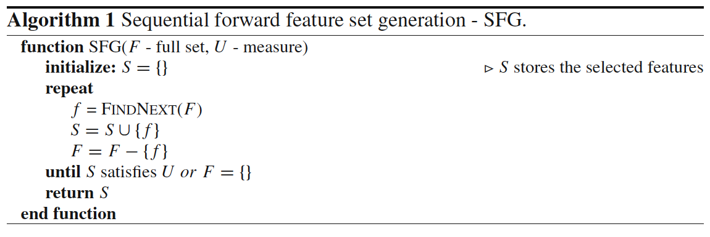
Perspectives:
Search of a Subset of Features
Search Directions:

Slide 12
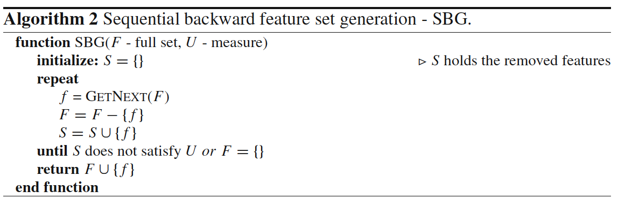
Perspectives:
Search of a Subset of Features
Search Directions:

Slide 13
Perspectives:
Search of a Subset of Features
Search Directions:
  Bidirectional Generation (BG): Begins the search in both directions, performing SFG and SBG concurrently. They stop in two cases: (1) when one search finds the best subset comprised of m features before it reaches the exact middle, or (2) both searches achieve the middle of the search space. It takes advantage of both SFG and SBG.
  Random Generation (RG): It starts the search in a random direction. The choice of adding or removing a features is a random decision. RGtries to avoid the stagnation into a local optima by not following a fixed way for subset generation. Unlike SFG or SBG, the size of the subset of features cannot be stipulated.

Slide 14
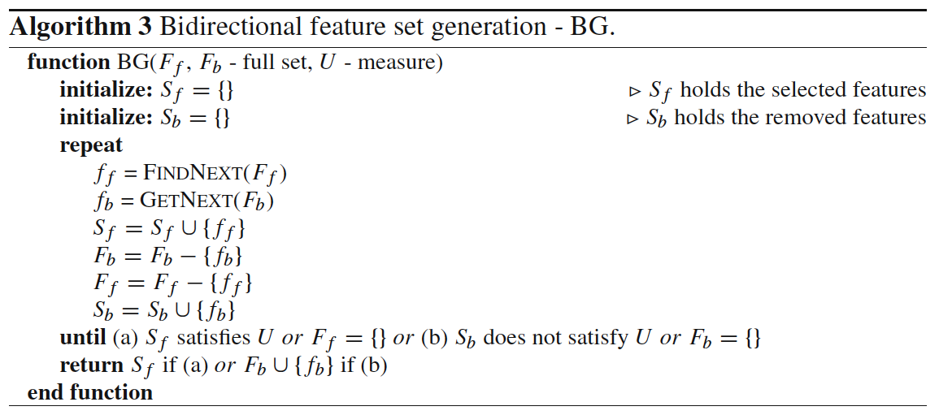
Perspectives:
Search of a Subset of Features
Search Directions:

Slide 15
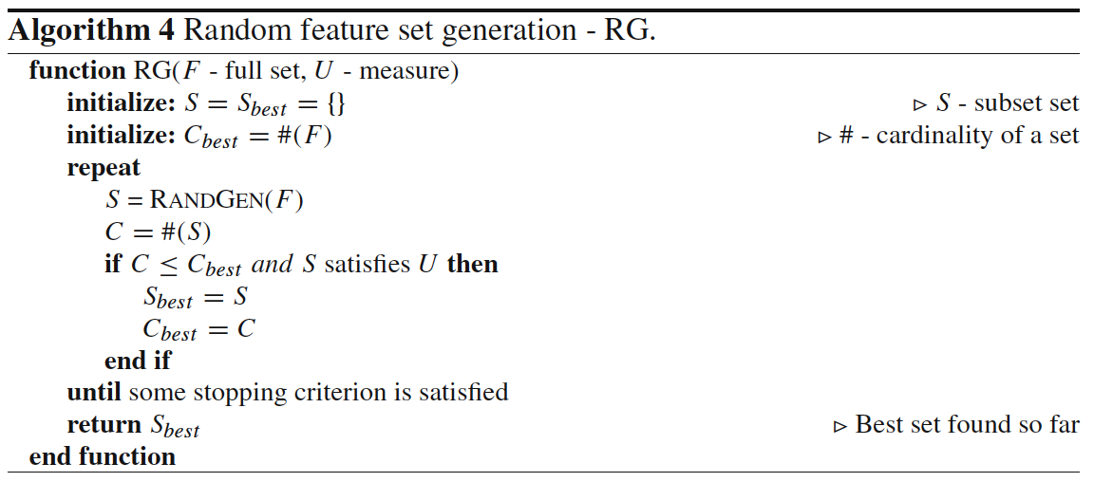
Perspectives:
Search of a Subset of Features
Search Directions:

Slide 16
Perspectives:
Search of a Subset of Features
Search Strategies:
  Exhaustive Search: It corresponds to explore all possible subsets to find the optimal ones. As we said before, the space complexity is O(2^{M}). If we establish a threshold m of minimum features to be selected and the direction of search, the search space is, independent of the forward or backward generation. Only exhaustive search can guarantee the optimality. Nevertheless, they are also impractical in real data sets with a high M.
  Heuristic Search: It employs heuristics to carry out the search. Thus, it prevents brute force search, but it will surely find a non-optimal subset of features. It draws a path connecting the beginning and the end of the previous Figure, such in a way of a depth-first search. The maximum length of this path is M and the number of subsets generated is O(M). The choice of the heuristic is crucial to find a closer optimal subset of features in a faster operation.

Slide 17
Perspectives:
Search of a Subset of Features
Search Strategies:
  Nondeterministic Search: Complementary combination of the previous two. It is also known as random search strategy and can generate best subsets constantly and keep improving the quality of selected features as time goes by. In each step, the next subset is obtained at random.
    it is unnecessary to wait until the search ends.
    we do not know when the optimal set is obtained, although we know which one is better than the previous one and which one is the best at the moment.

Slide 18

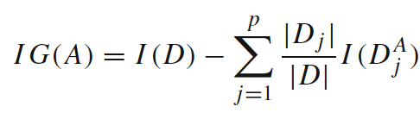
Perspectives:
Selection Criteria
  Information Measures.
    Information serves to measure the uncertainty of the receiver when she/he receives a message.
    Shannon’s Entropy:
    Information gain:

Slide 19
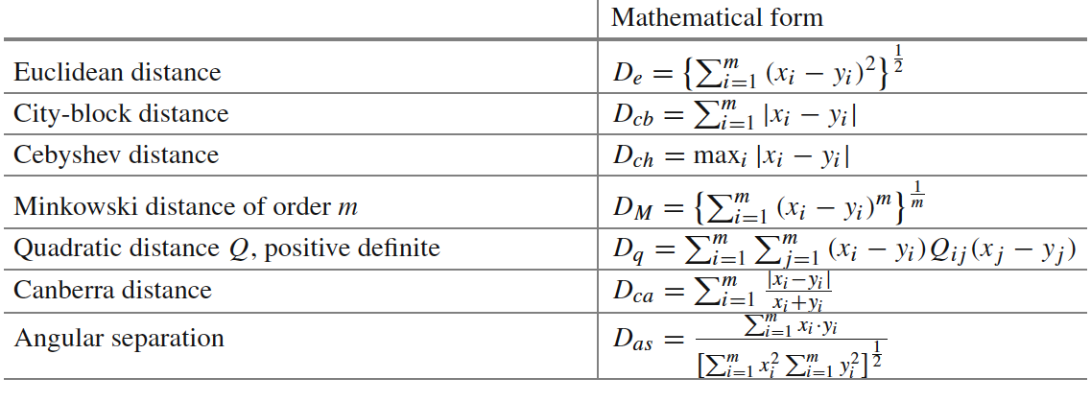
Perspectives:
Selection Criteria
  Distance Measures.
    Measures of separability, discrimination or divergence measures . The most typical is derived from distance between the class conditional density functions.

Slide 20
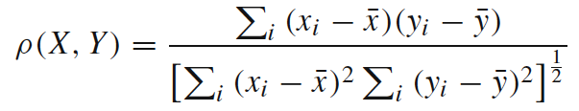
Perspectives:
Selection Criteria
  Dependence Measures.
    known as measures of association or correlation.
    Its main goal is to quantify how strongly two variables are correlated or present some association with each other, in such way that knowing the value of one of them, we can derive the value for the other.
    Pearson correlation coefficient:

Slide 21
Perspectives:
Selection Criteria
  Consistency Measures.
    They attempt to find a minimum number of features that separate classes as the full set of features can.
    They aim to achieve P(C|FullSet) = P(C|SubSet).
    An inconsistency is defined as the case of two examples with the same inputs (same feature values) but with different output feature values (classes in classification).

Slide 22
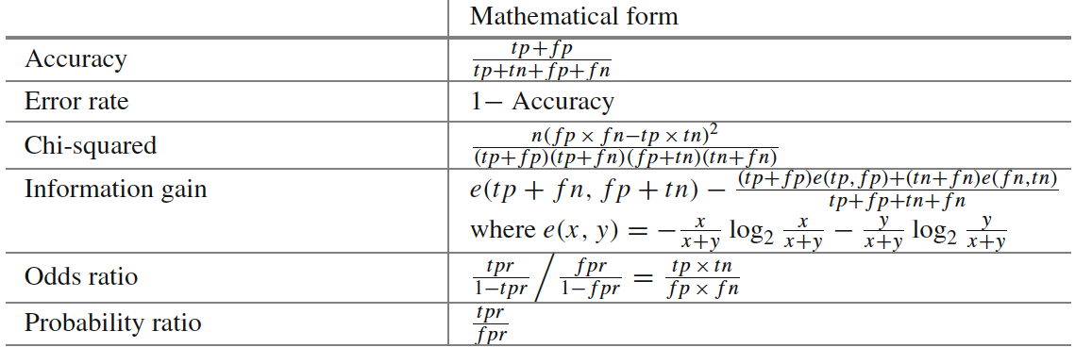
Perspectives:
Selection Criteria
  Accuracy Measures.
    This form of evaluation relies on the classifier or learner. Among various possible subsets of features, the subset which yields the best predictive accuracy is chosen

Slide 23
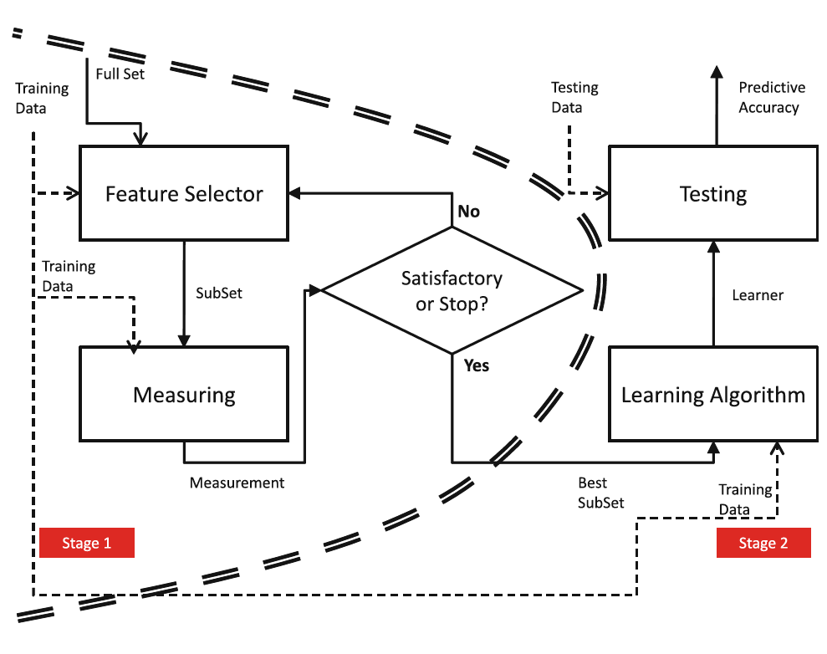
Perspectives
Filters:

Slide 24
Perspectives
Filters:
  measuring uncertainty, distances, dependence or consistency is usually cheaper than measuring the accuracy of a learning process. Thus, filter methods are usually faster.
  it does not rely on a particular learning bias, in such a way that the selected features can be used to learn different models from different DM techniques.
  it can handle larger sized data, due to the simplicity and low time complexity of the evaluation measures.

Slide 25
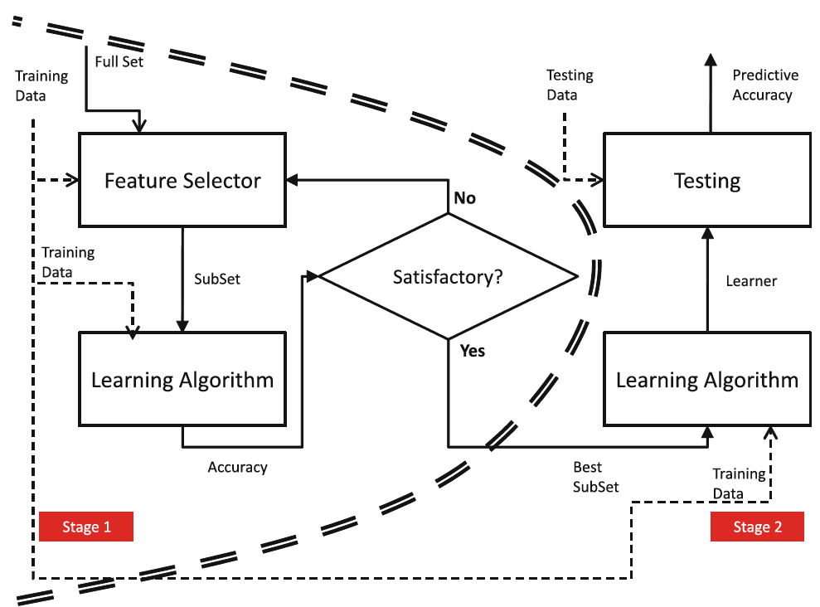
Perspectives
Wrappers:

Slide 26
Perspectives
Wrappers:
  can achieve the purpose of improving the particular learner’s predictive performance.
  usage of internal statistical validation to control the overfitting, ensembles of learners and hybridizations with heuristic learning like Bayesian classifiers or Decision Tree induction.
  filter models cannot allow a learning algorithm to fully exploit its bias, whereas wrapper methods do.

Slide 27
Perspectives
Embedded FS:
  similar to the wrapper approach in the sense that the features are specifically selected for a certain learning algorithm, but in this approach, the features are selected during the learning process.
  they could take advantage of the available data by not requiring to split the training data into a training and validation set; they could achieve a faster solution by avoiding the re-training of a predictor for each feature subset explored.

Slide 28
Feature Selection
Overview
Perspectives
Aspects
Most Representative Methods
Related and Advanced Topics
Experimental Comparative Analyses

Slide 29
Aspects:
Output of Feature Selection
Feature Ranking Techniques:
  we expect as the output a ranked list of features which are ordered according to evaluation measures.
  they return the relevance of the features.
  For performing actual FS, the simplest way is to choose the first m features for the task at hand, whenever we know the most appropriate m value.

Slide 30
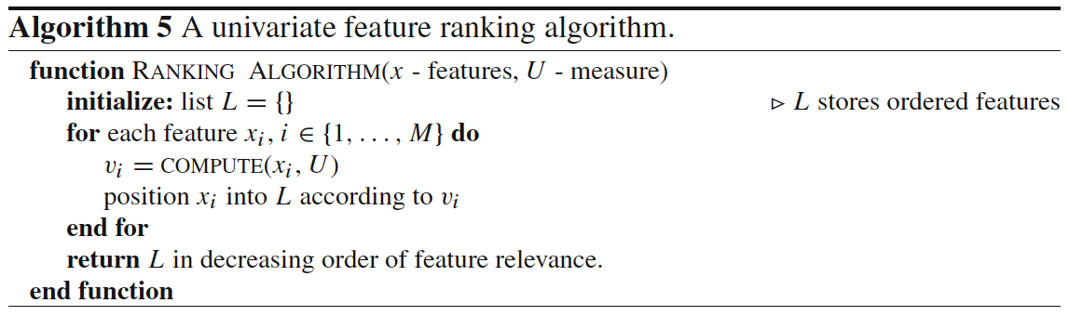
Aspects:
Output of Feature Selection
Feature Ranking Techniques:

Slide 31
Aspects:
Output of Feature Selection
Minimum Subset Techniques:
  The number of relevant features is a parameter that is often not known by the practitioner.
  There must be a second category of techniques focused on obtaining the minimum possible subset without ordering the features.
  whatever is relevant within the subset, is otherwise irrelevant.

Slide 32
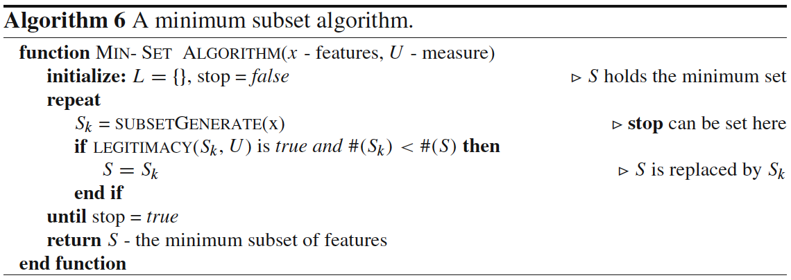
Aspects:
Output of Feature Selection
Minimum Subset Techniques:

Slide 33
Aspects:
Evaluation
Goals:
  Inferability: For predictive tasks, considered as an improvement of the prediction of unseen examples with respect to the direct usage of the raw training data.
  Interpretability: Given the incomprehension of raw data by humans, DM is also used for generating more understandable structure representation that can explain the behavior of the data.
  Data Reduction: It is better and simpler to handle data with lower dimensions in terms of efficiency and interpretability.

Slide 34
Aspects:
Evaluation
We can derive three assessment measures from these three goals:
  Accuracy
  Complexity
  Number of Features Selected
  Speed of the FS method
  Generality of the features selected

Slide 35
Aspects:
Drawbacks
The resulted subsets of many models of FS are strongly dependent on the training set size.
It is not true that a large dimensionality input can always be reduced to a small subset of features because the objective feature is actually related with many input features and the removal of any of them will seriously effect the learning performance.
A backward removal strategy is very slow when working with large-scale data sets. This is because in the firsts stages of the algorithm, it has to make decisions funded on huge quantities of data.
In some cases, the FS outcome will still be left with a relatively large number of relevant features which even inhibit the use of complex learning methods.

Slide 36
Aspects:
Using Decision Trees for FS
Decision trees can be used to implement a trade-off between the performance of the selected features and the computation time which is required to find a subset.
Decision tree inducers can be considered as anytime algorithms for FS, due to the fact that they gradually improve the performance and can be stopped at any time, providing sub-optimal feature subsets.

Slide 37
Feature Selection
Overview
Perspectives
Aspects
Most Representative Methods
Related and Advanced Topics
Experimental Comparative Analyses

Slide 38
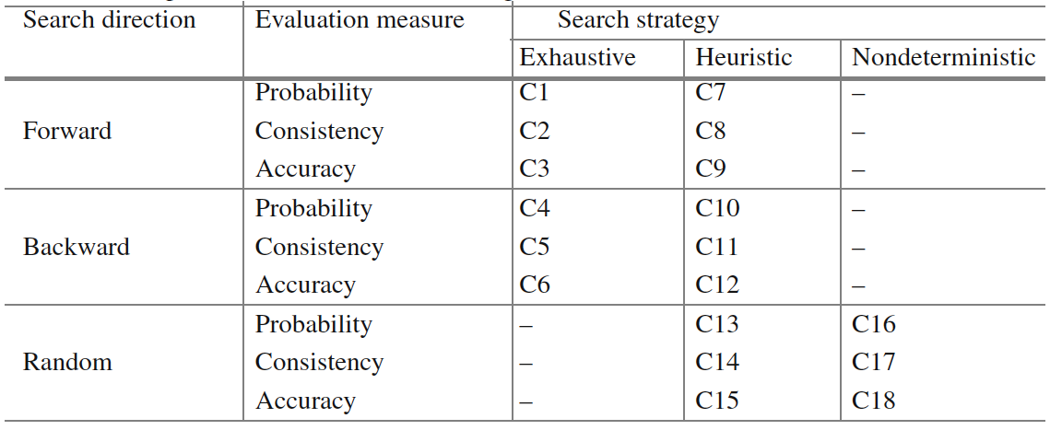
Most Representative Methods
Three major components to categorize combinations:
  Search Direction
  Search Strategy
  Evaluation Measure

Slide 39
Most Representative Methods
Exhaustive Methods
Cover the whole search space.
Six Combinations (C1-C6).
  Focus method: C2.
  Automatic Branch and Bound (ABB): C5.
  Best First Search (BFS): C1.
  Beam Search: C3.
  Branch and Bound (BB): C4.

Slide 40
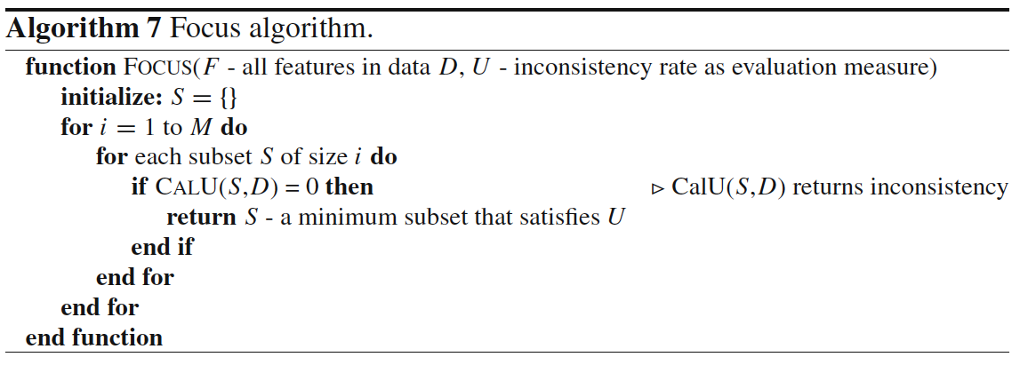
Most Representative Methods
Exhaustive Methods

Slide 41
Most Representative Methods
Heuristic Methods
They do not have any expectations of finding an optimal subset with a rapid solution.
Nine Combinations (C7-C15).
  Use a DM algorithm for FS: C12.
  Wrapper Sequential Forward Selection: C9.
  SetCover: C8.
  Heuristic search algorithm and in each sub-search space: C13-C15.
  MIFS: C10.

Slide 42
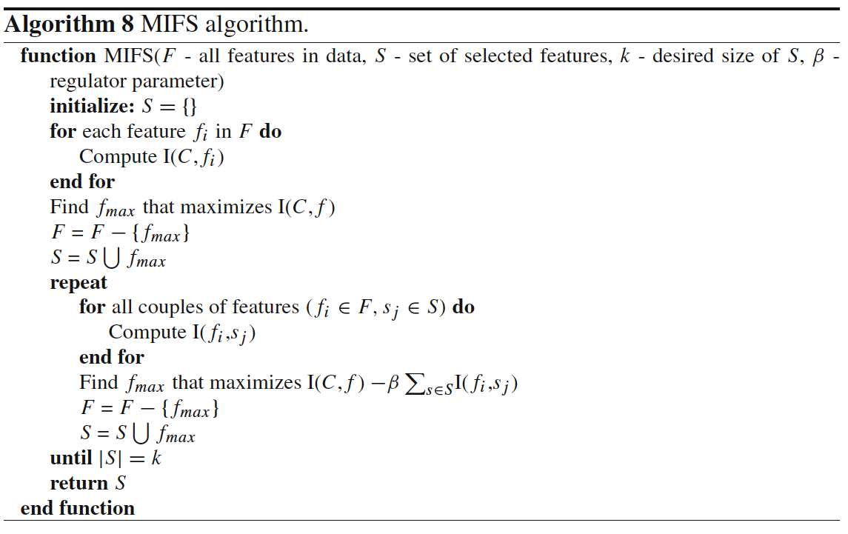
Most Representative Methods
Heuristic Methods

Slide 43
Most Representative Methods
Nondeterministic Methods
They add or remove features to and from a subset without a sequential order.
Three Combinations (C16-C18).
  Simulated Annealing / Genetic Algorithms are the most common techniques.
  LVF: C17.
  LVW: C18.

Slide 44
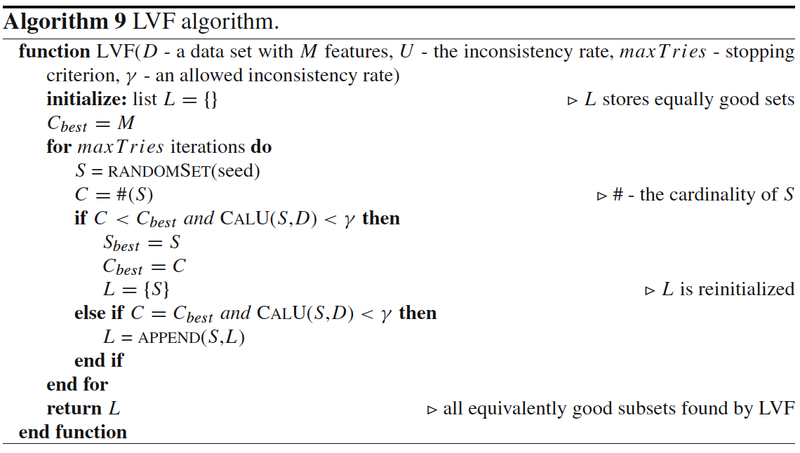
Most Representative Methods
Nondeterministic Methods

Slide 45
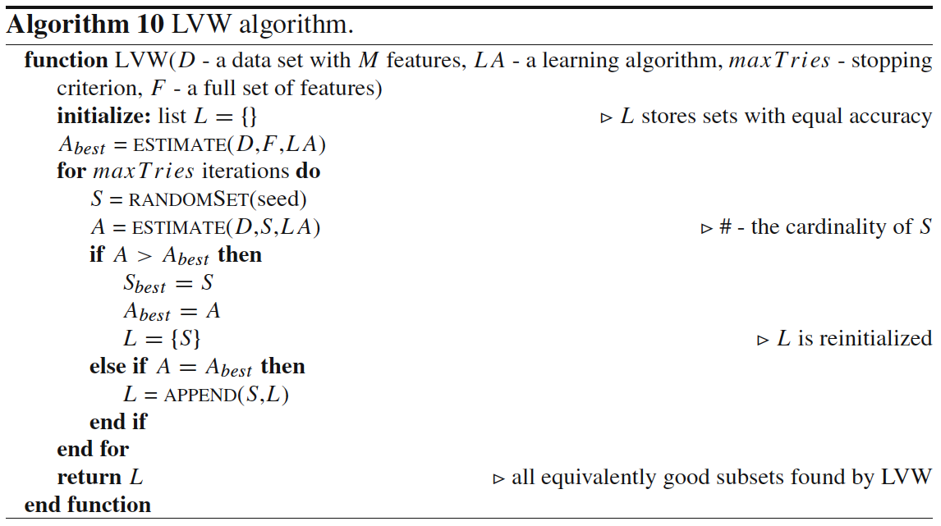
Most Representative Methods
Nondeterministic Methods

Slide 46
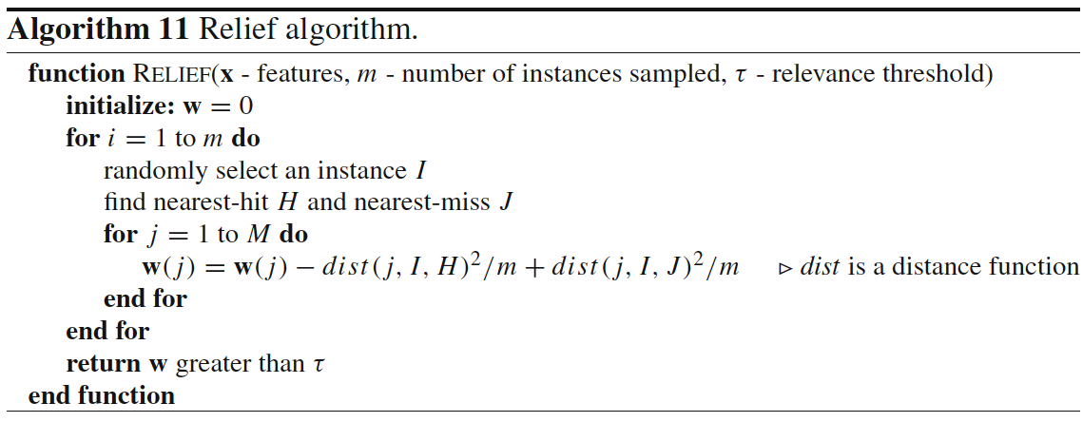
Most Representative Methods
Feature Weighting Methods
Provide weights to features, also can be used for FS.
Relief (binary) and ReliefF (multipe classes).

Slide 47
Feature Selection
Overview
Perspectives
Aspects
Most Representative Methods
Related and Advanced Topics
Experimental Comparative Analyses

Slide 48
Related and Advanced Topics
Leading and Recent FS Techniques
The related literature is huge, quite chaotic and difficult to understand or categorize the differences among the hundreds of algorithms published.
Focus attention on the main ideas that lead to updates and improvements.

Slide 49
Related and Advanced Topics
Leading and Recent FS Techniques
Modifications of classical FS:
  MIFS-U, MIFS based on Parzen window, mRMR, NMIFS.
  Several Relief modifications: Iterative-RELIEF.
Separability and Similarity:
  Kernel class separability.
  Common subspace measure and Fisher subspace measure combination.
  The redundancy-constrained FS (RCFS).
  Many more…

Slide 50
Related and Advanced Topics
Leading and Recent FS Techniques
Use of meta-heuristics:
  Genetic algorithms.
  Tabu search.
  Hybridizations between genetic algorithms and local searches.
Rough Sets theory:
  evaluation criteria based onn reducts and approximations.
  Fuzzy Rough FS (FRFS).

Slide 51
Related and Advanced Topics
Leading and Recent FS Techniques
Fusion of filters and wrappers:
  Evaluation criteria merging dependency, coefficients of correlations and error estimation by KNN.
  GAMIFS: genetic algorithm to form an hybrid filter/wrapper.
Extremely high-dimensional data:
  Reduction of the FS task to a quadratic optimization problem: QPFS.
  Big Data solutions.

Slide 52
Related and Advanced Topics
Feature Extraction
Find new features that are calculated as a function of the original features.
Dimensionality Reduction is done by mapping a multidimensional space into a space of fewer dimensions.
It is another name given to Space Transformations.

Slide 53
Related and Advanced Topics
Feature Construction
Attach to the algorithms some mechanism to compound new features from the original ones endeavouring to improve accuracy and the decrease in model complexity.
They have been extensively applied on separate-and-conquer predictive learning approaches.

Slide 54
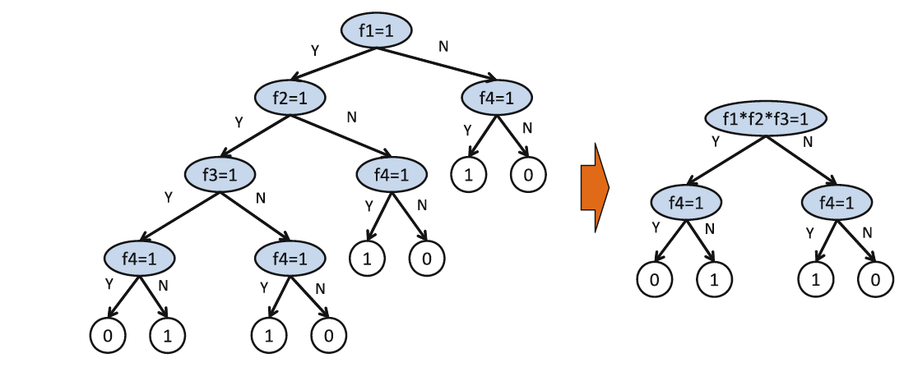
Related and Advanced Topics
Feature Construction
Constructive operators:
  Product, inequality, maximum, minimum, average, addition, substraction, division, count, …

Slide 55
Feature Selection
Overview
Perspectives
Aspects
Most Representative Methods
Related and Advanced Topics
Experimental Comparative Analyses

Slide 56
Experimental Comparative Analyses
Summary of some major studies:
  With 1-NN, the main conclusions point to the use of the bidirectional approaches for small and medium scale data sets.
  Regarding evaluation measures, the inconsistency criterion was emphasized in several aspects.
  Evaluation measure + stopping criterion: information theory based functions obtain better accuracy results; no cutting criterion can be generally recommended.
  On synthetic data, ReliefF turned out to be the best option independent of the particulars of the data.

